Slide 1

Building the Next Generation Teaching and Learning Environment
Charles Severance
University of Michigan School of Information
Sakai PMC Chair

Slide 2

Enterprise Learning Management System (LMS) Been there – done that – got the tattoo.. But…

Slide 3

http://planet-fall.deviantart.com/art/The-Monolith-80407794

Slide 4
Enterprise Solutions
Campus-wide Learning Management Systems
Sakai, Canvas, Moodle, Blackboard, Desire2Learn… 100s more
Learning Object Repositories
Canvas Commons, Blackboard xpLor, MERLOT
Massive Publishers
Pearson, McGraw-Hill, K12.com
MIT Open Courseware, etc
Coursera, Udacity, Lynda, Udemy, edX

Slide 5
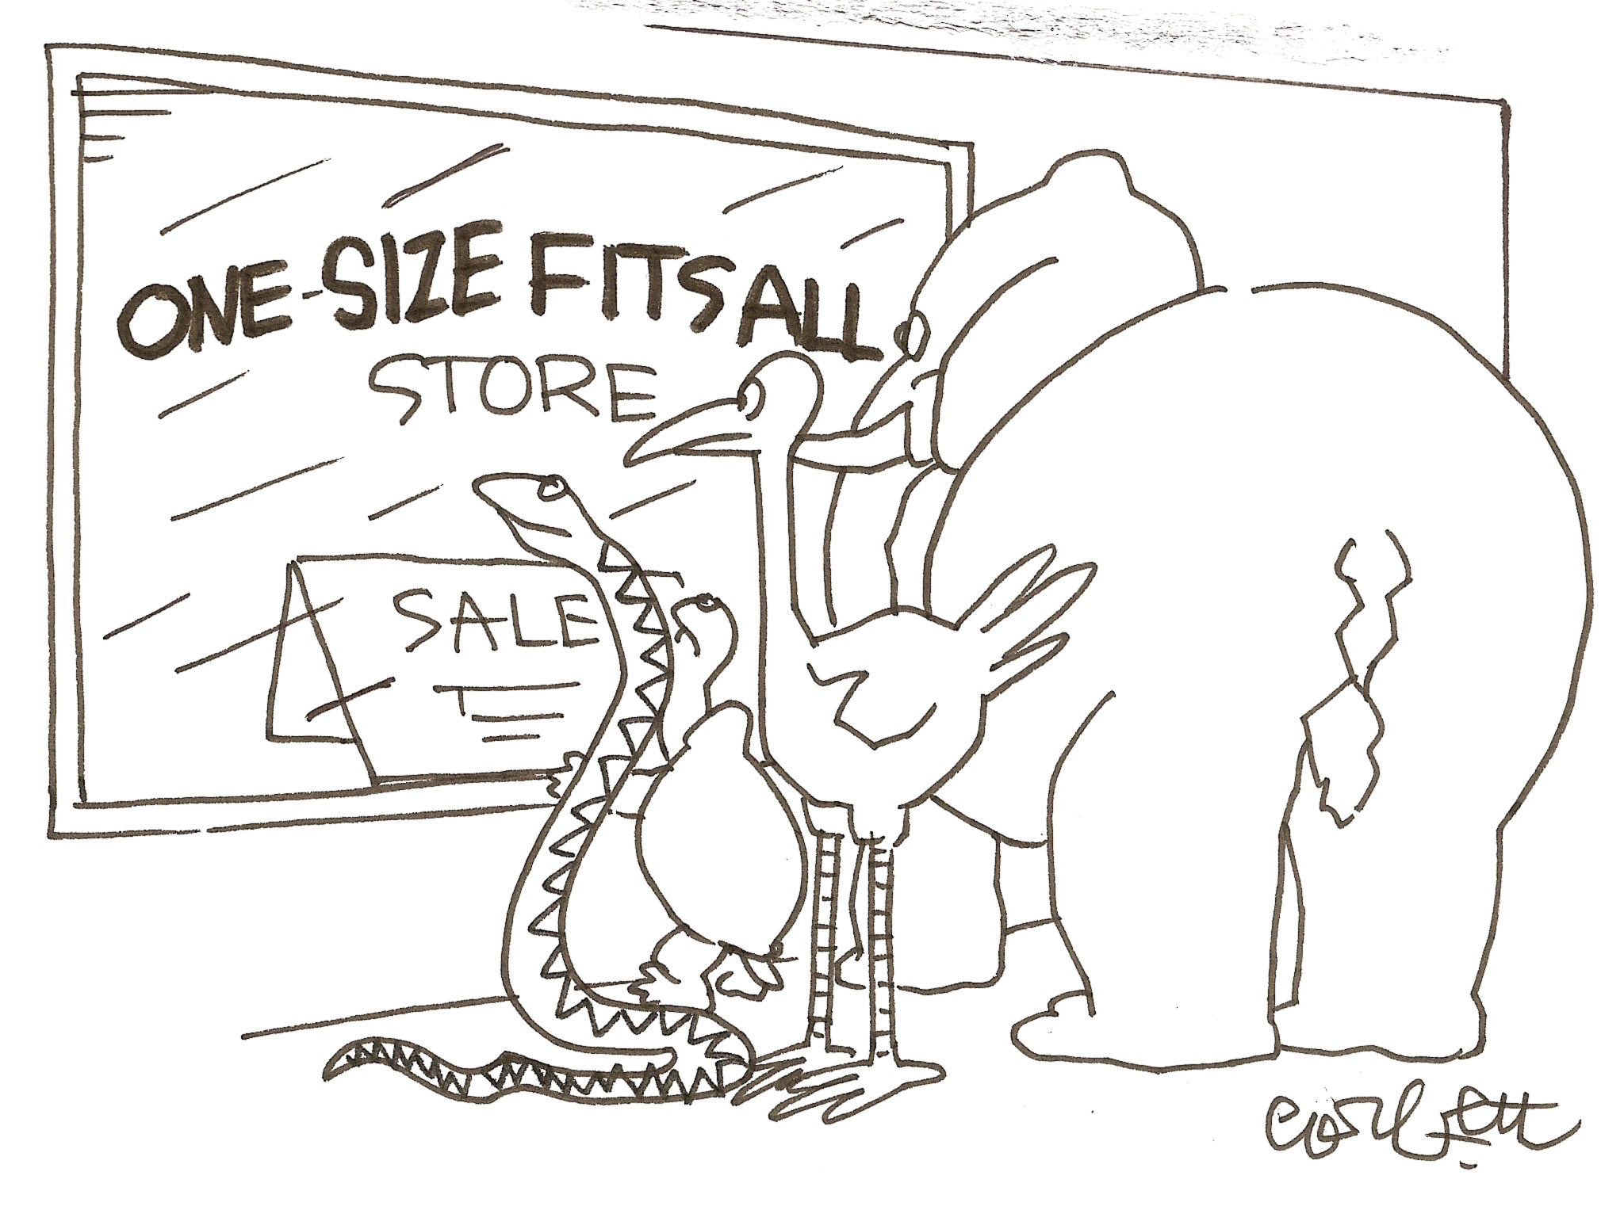

Slide 6
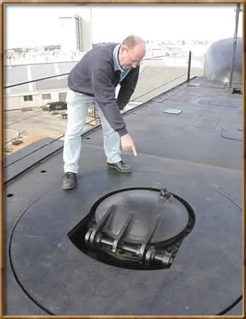

Standards 1.0
IMS Learning Tools Interoperability (LTI) 1.0
17 May 2010
IMS Common Cartridge 1.0
1 October 2008

Slide 7






Slide 8
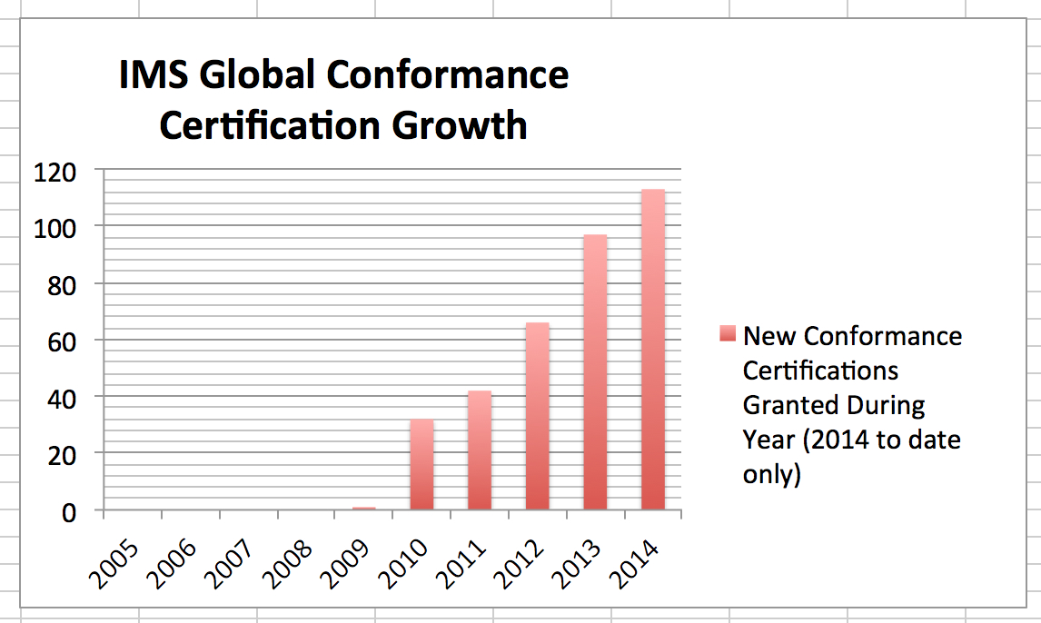


Slide 10


































Slide 11


Open Educational Resources
Standards
MOOCs
Next Generation Digital Learning Environment

Slide 12
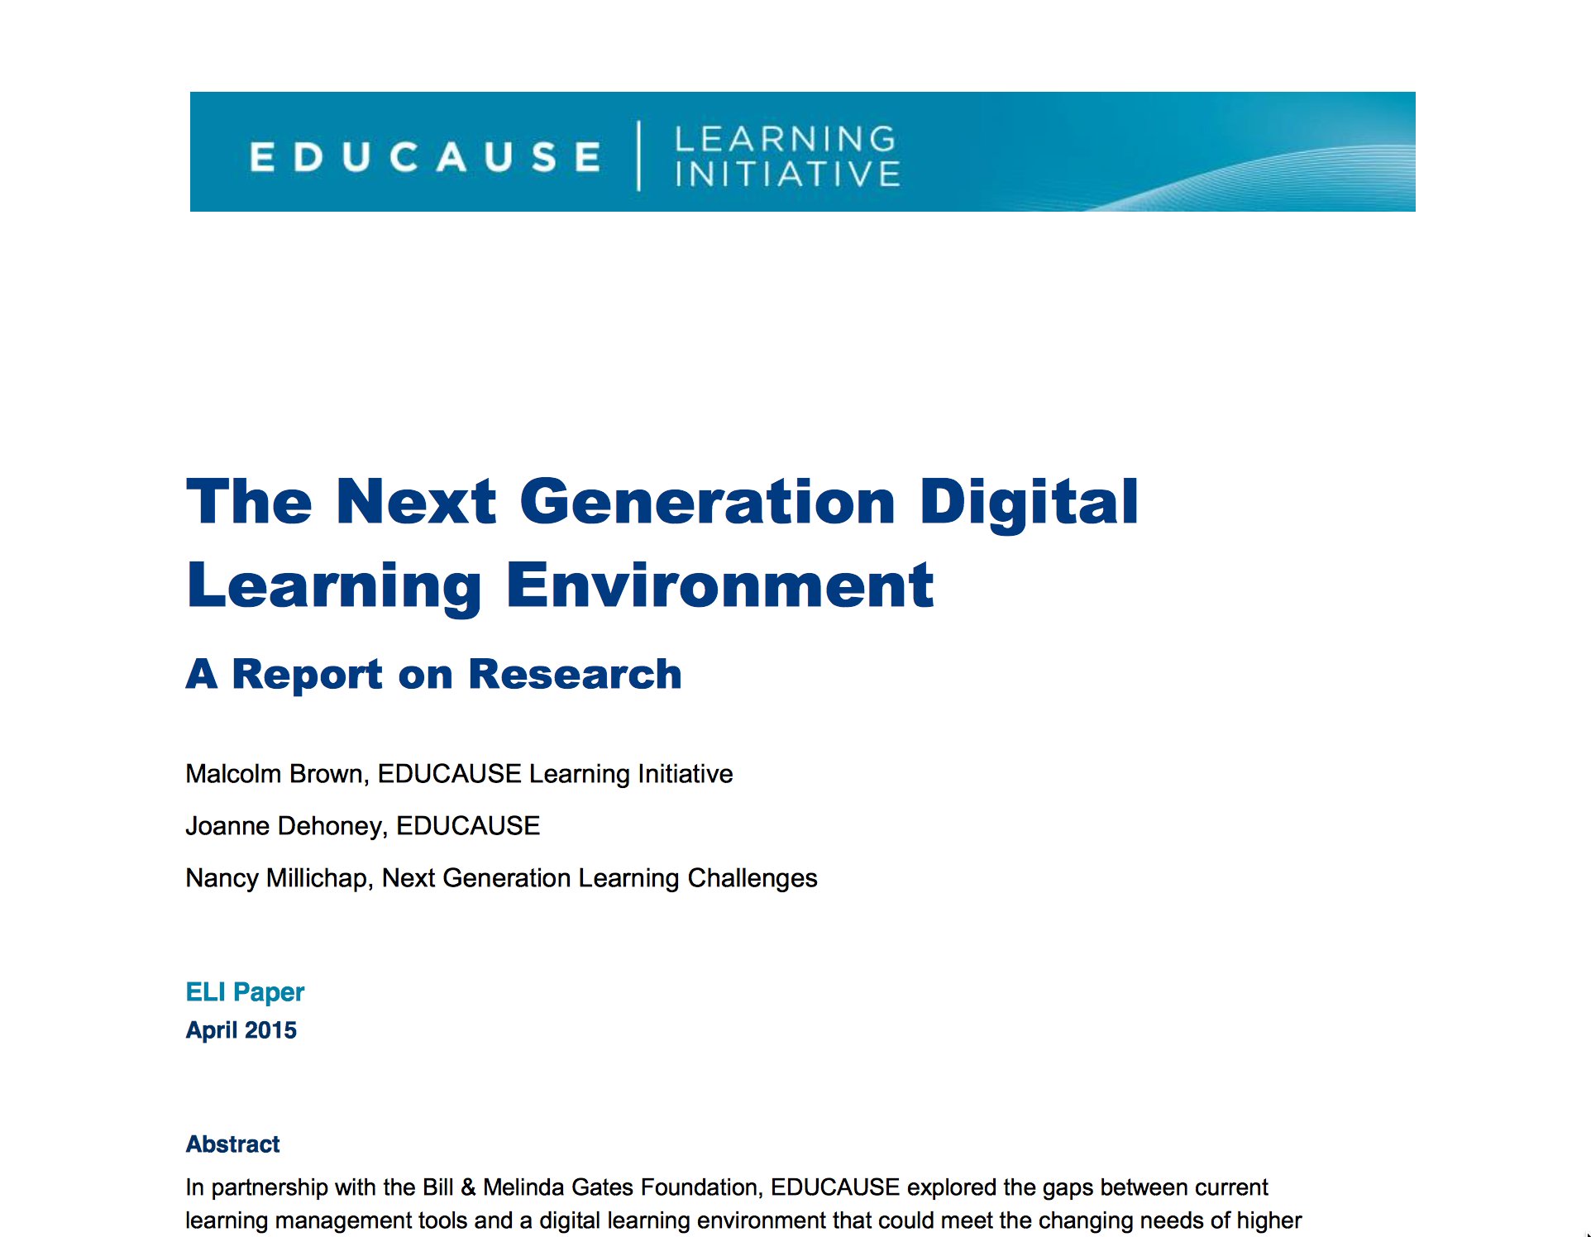
https://net.educause.edu/ir/library/pdf/eli3035.pdf

Slide 13
NGDLE Monolith-Style
Repositories
Blackboard xpLor
Canvas Commons
App Store:
Canvas EduAppCenter
Small LMS + App Store + Marketed to Teacher
Edmodo – App Store not LTI
Schoology – App Store with LTI

Slide 14


Standards Next Gen
IMS Common Cartridge – 1.0, 1.1, 1.2, 1.3, 2.0
IMS Learning Tools Interoperability 1.0, 1.1, 2.0, 2.1, 2.2
IMS LTI Content Item - Public Draft
IMS LTI Roster Services – WG Draft
IMS LTI Outcomes 2 – in WG Draft
IMS Caliper 1.0
IMS OneRoster – Rest-based SIS integration
IMS CASA App Store – Relaunching
IMS CC / EPUB 3.0 Coordination

Slide 15
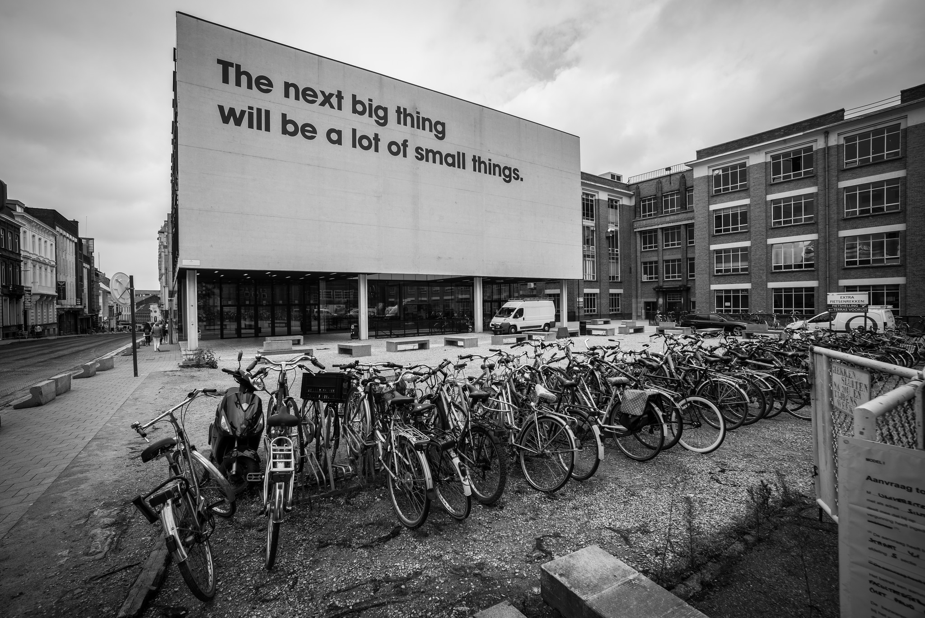
Source: Ian Dolphin

Slide 16
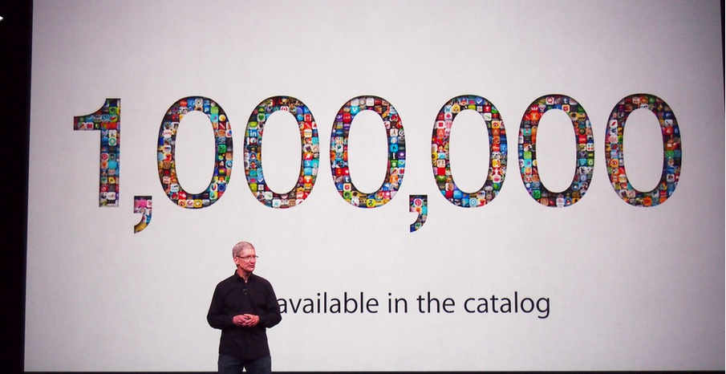
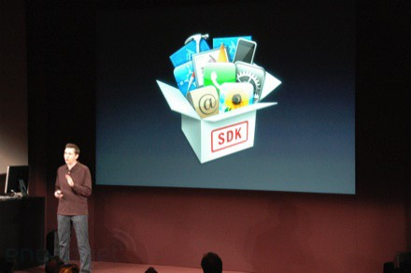
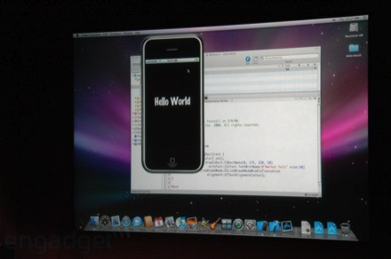
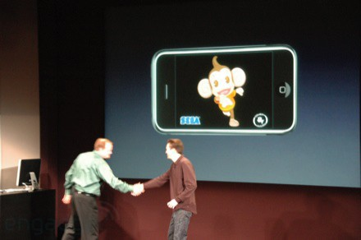
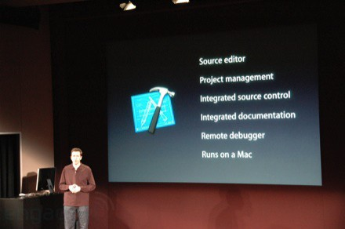
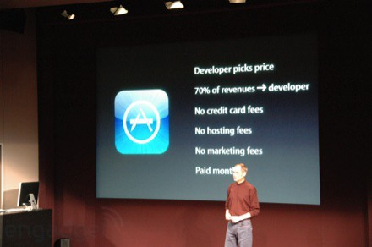
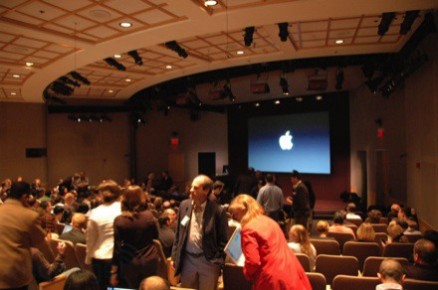
March 6, 2008 iPhone SDK Press Conference

Slide 17

http://planet-fall.deviantart.com/art/The-Monolith-80407794
https://pixabay.com/static/uploads/photo/2014/12/02/22/05/snowflake-554635_960_720.jpg

Slide 18
Easy or Not?
Need to develop standards for interoperability
Need to train 1000's of developers to implement the standards
As standards improve they expand and get more complex

Slide 19
Easy or Not?
Need to develop standards for interoperability
Need to train 1000's of developers to implement the standards
As standards improve they expand and get more complex
Impossible?

Slide 20
We need "WordPress"
A free downloadable off-the-shelf software package that gets people going quickly
Allow thousands of educational sites to be built and put into production by anyone

Slide 21
"EduPress"
An Learning Management System (LMS) of my own
An Open Educational Resource site of my own
A Learning Object Repository (LOR) of my own
A Learning Record Store (LRS) of my own
Millions of sites – millions of courses all similar with a common structure but all unique and distinct

Slide 22
What is Tsugi?
Software to allow anyone to build and deploy interoperable educational web sites, content, and learning tools

Slide 23
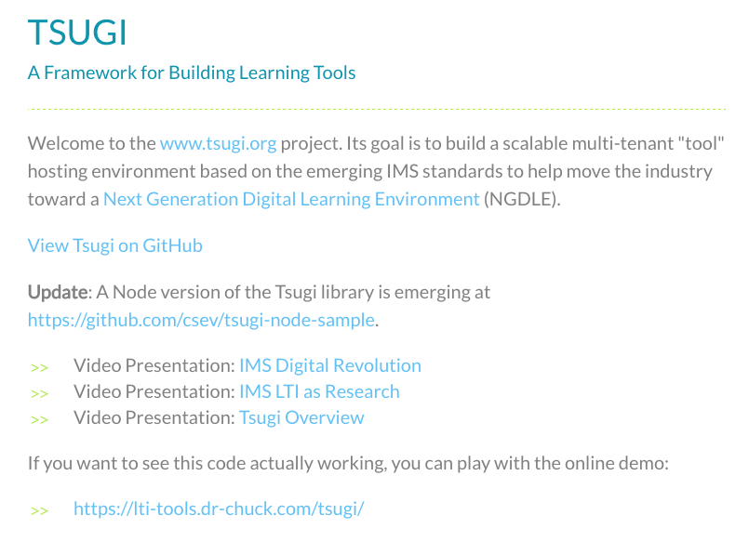
www.tsugi.org

Slide 24
What's in Tsugi?
A Course-Oriented LMS
App Store for Learning Applications
Course-Oriented Content Repository
API Libraries – PHP, Java, Python, Node...
Open source standards implementations
Training for Developers (www.wa4e.com)

Slide 25
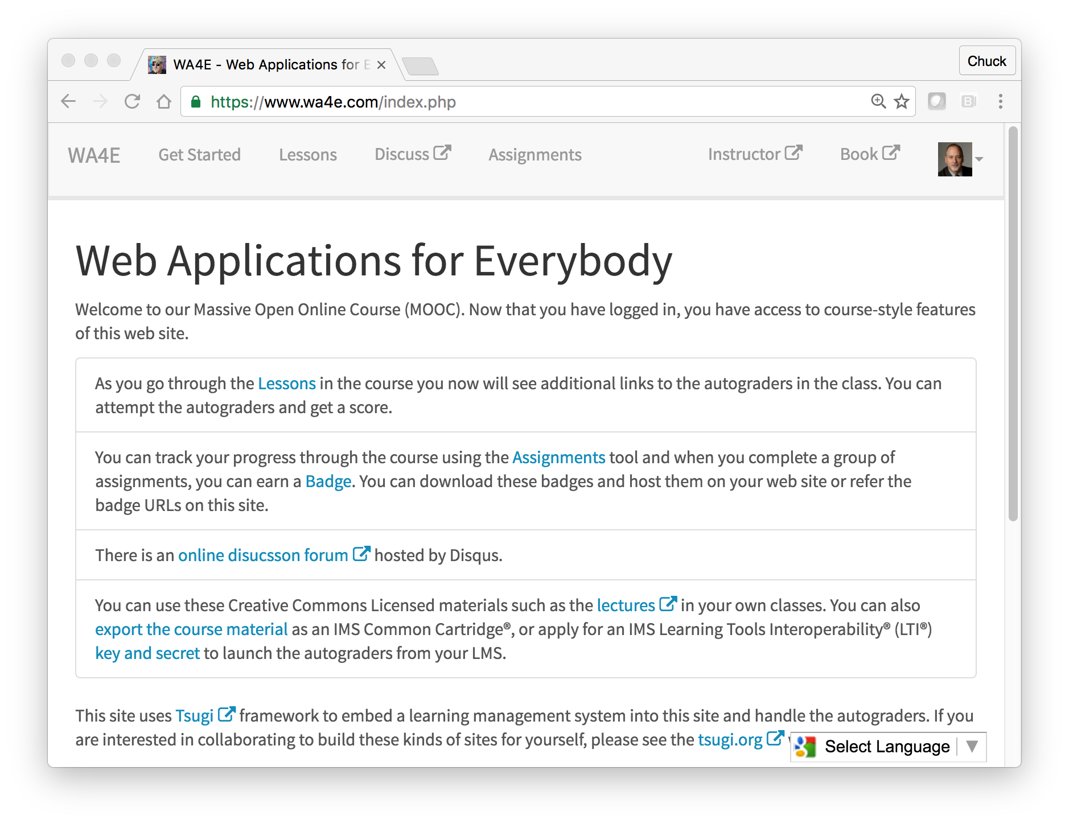
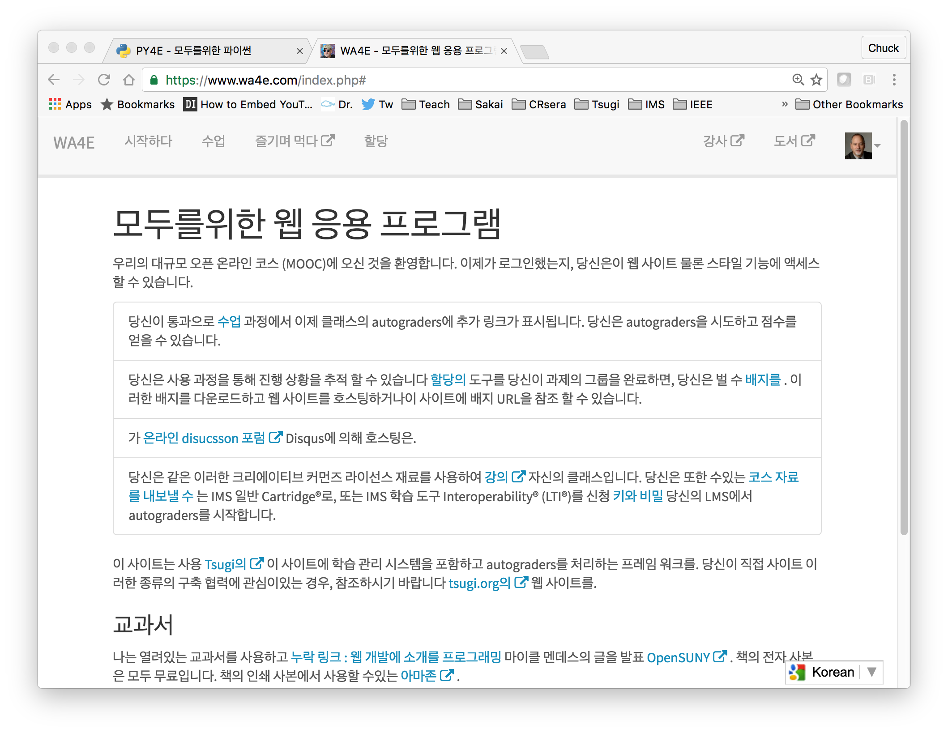
WA4E.com

Slide 26
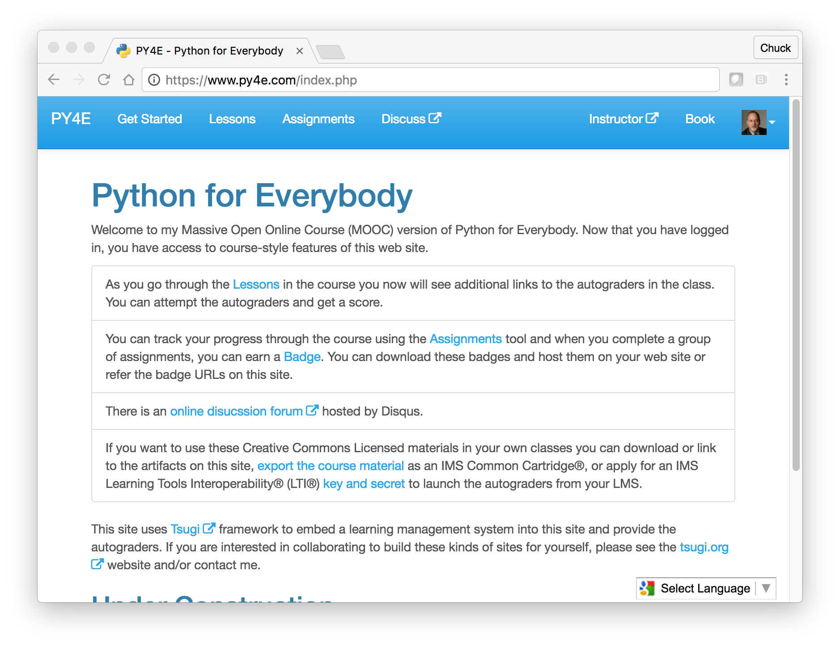
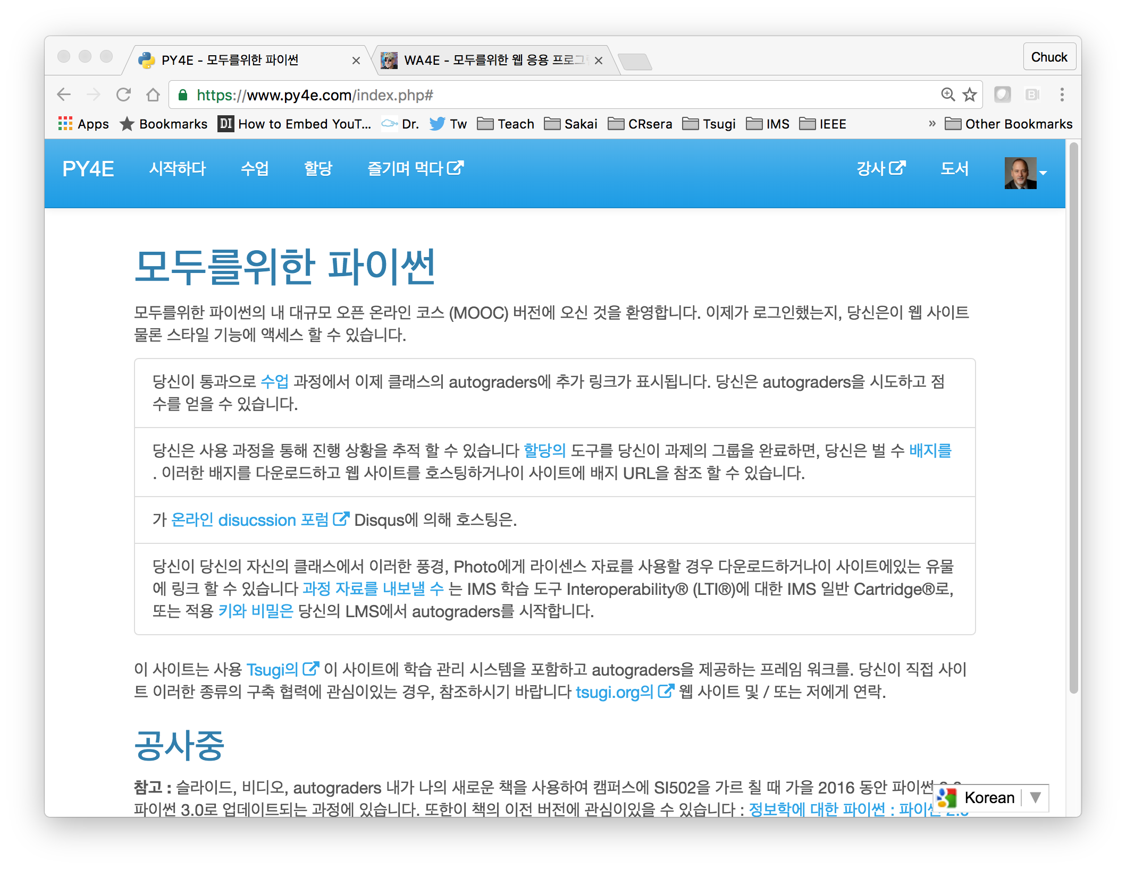
PY4E.com

Slide 27
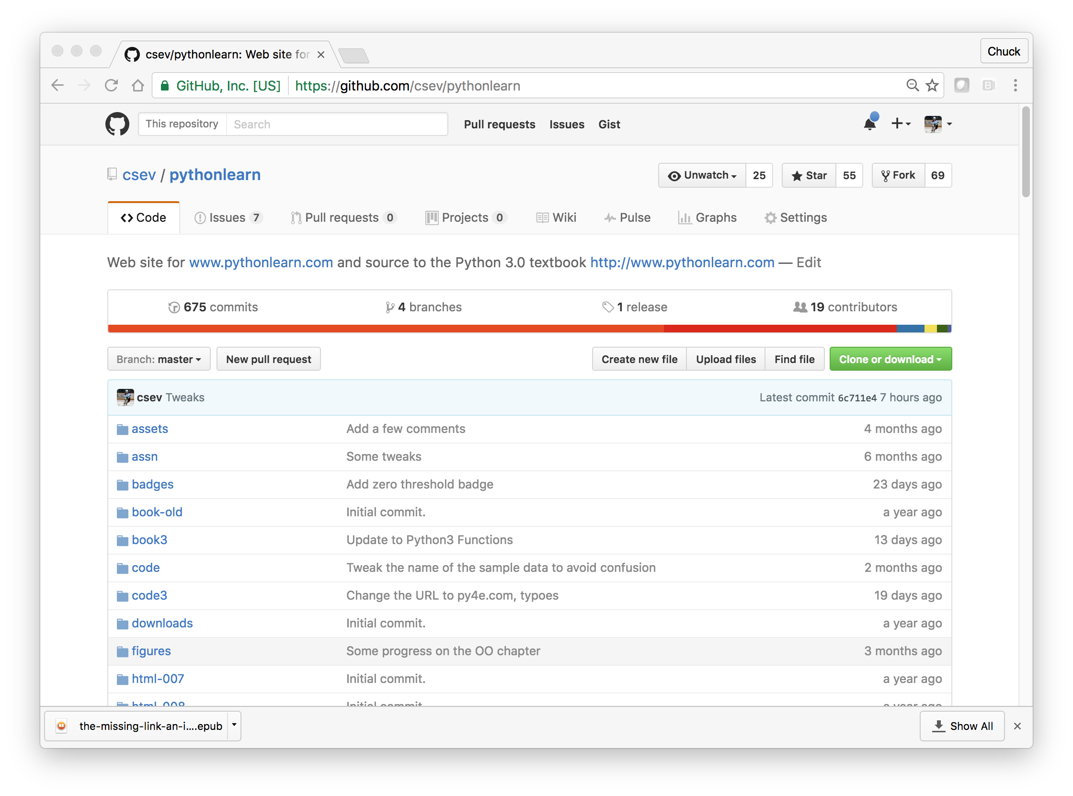

https://github.com/csev/pythonlearn

Slide 28
Inside Tsugi

Slide 29
Issues in Learning Applications
Session Management / Expiry
Offline Grading – Peer grading Applications
Coping with unreliable Tool Consumers – Grade resend
Instructor grade detail
Thin Cartridge
Settings on URL
Setting Dialogs Cross-LMS
Making Proxy / CDN
windows.post messages
Dealing with vendor extensions - working across vendor

Slide 30
Tsugi Store
Tsugi
Console
APP
Tsugi
PHP
MySQL
Database
APP
LMS/CMS
APP
Canvas
Sakai
Coursera
Tsugi
Moodle
…
APP
Tsugi
Java
APP
APP
LTI
APP
Tsugi
Node
APP
APP
Python
Test
CC
Tsugi
LOR

Slide 31
Tsugi APIs
Tsugi Module
Tsugi App
???
UI/UX APIs
Look / Feel
UI Widgets
Opinionated APIs
Convention / Database Model / Session
Easy for App Developer to Use
Utility APIs
Implement Standards
Portable / Resuable outside Tsugi

Slide 32
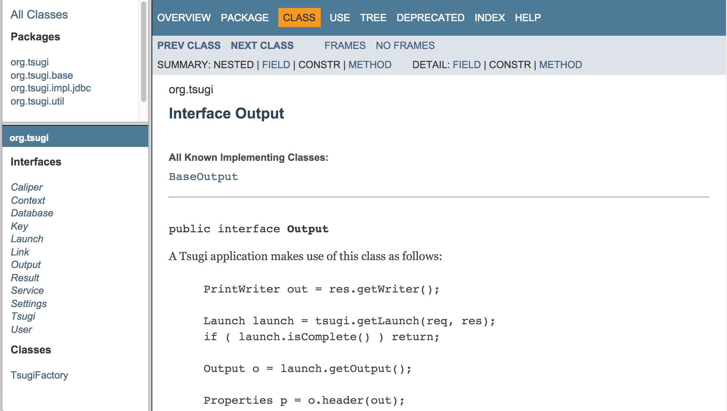
UI/UX API
http://csev.github.io/tsugi-java/apidocs/index.html

Slide 33
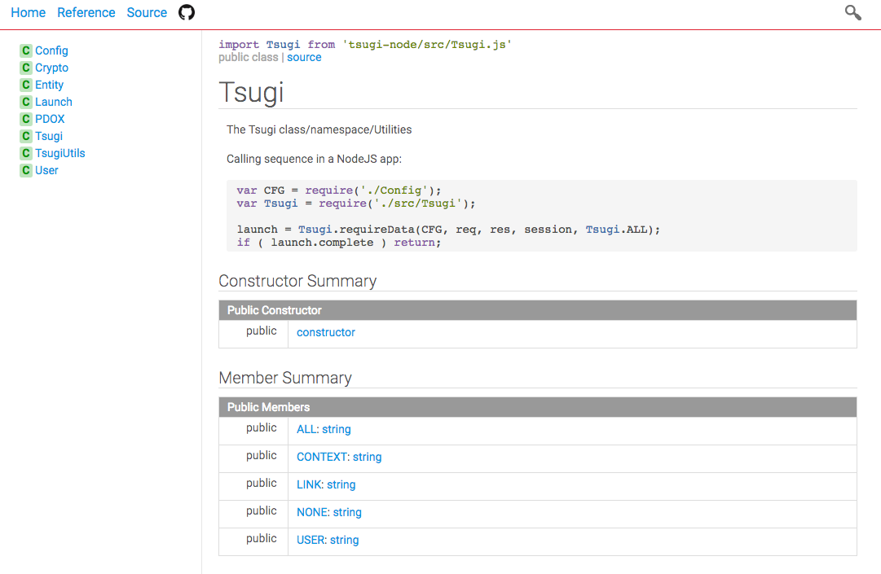
Opinionated API
http://do1.dr-chuck.com/tsugi-node/esdoc/

Slide 34
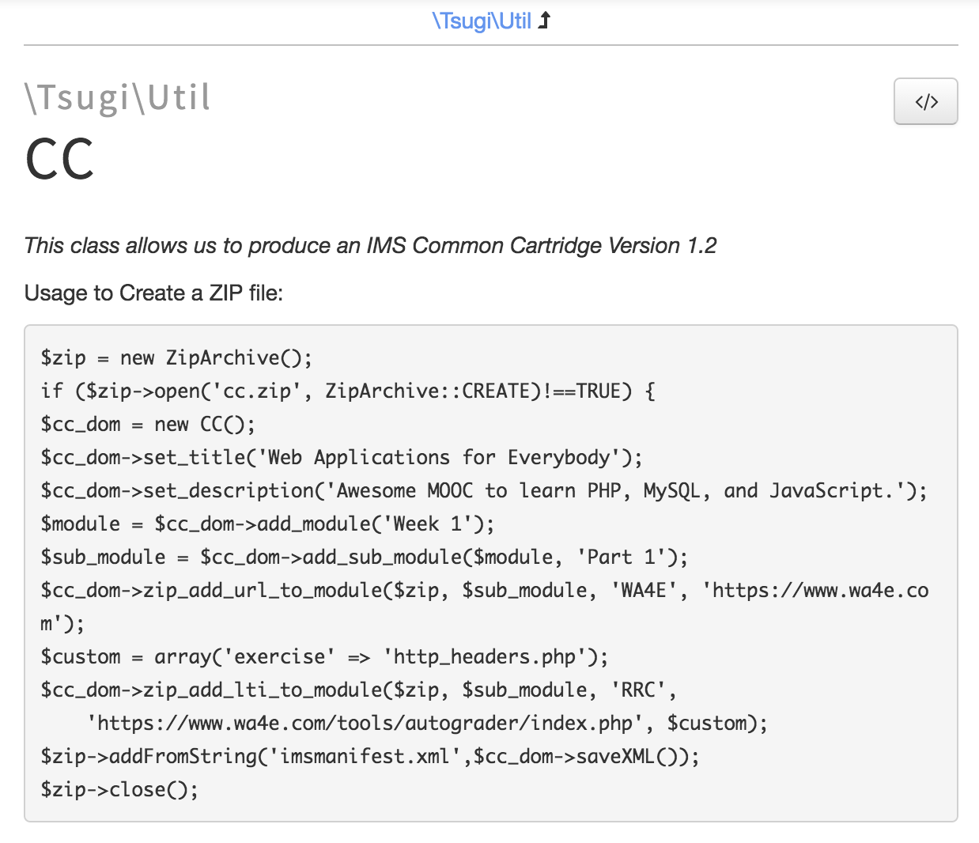
Utility API
http://do1.dr-chuck.com/tsugi/phpdoc/classes/Tsugi.Util.CC.html

Slide 35
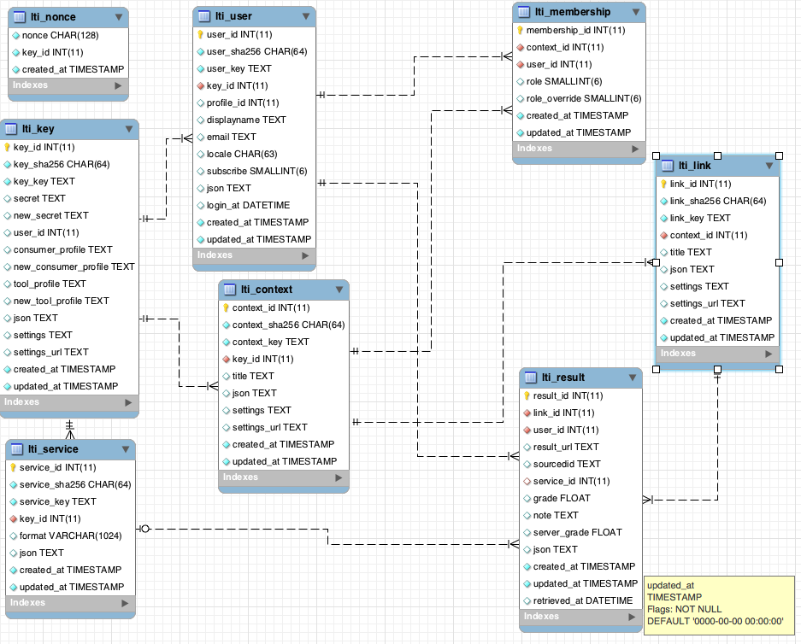
Tsugi Data Model
tsugi/docs/lectures/02-Data-Model-Workbench.mwb

Slide 36
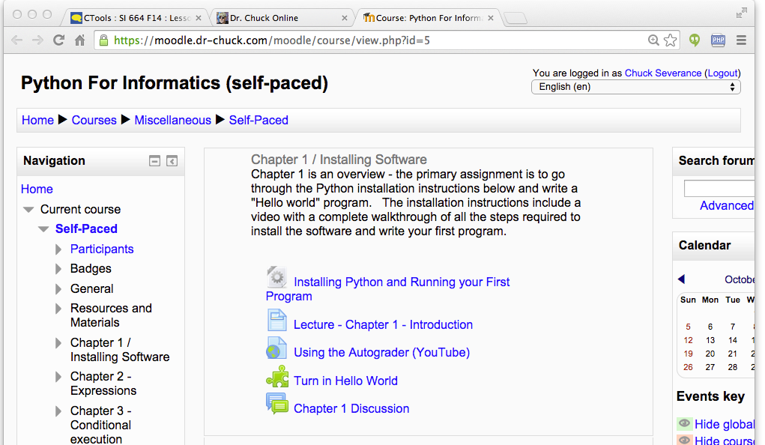
Tenant
Context
User
Link (Many)

Slide 37
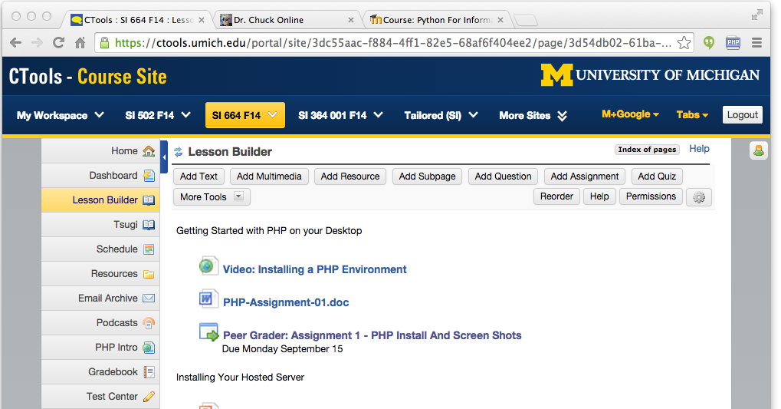
Tenant
Context
User
Link (Many)

Slide 38
Tsugi Tools To Date
App Store
Google Class Map
GIFT Quiz Engine
Grade book
Attendance Tool
Video Tracker (*)
Clicker (*)
HTML5 Autograder
Python Autograder
SQL Autograder
DataMining Autograder
PHP Autograder
https://lti-tools.dr-chuck.com/tsugi Developer -> "secret"

Slide 39
Tsugi Developer Training
PHP / MySQL – www.php-intro.com
Tsugi Recorded Lecture Series
http://lectures.tsugi.org/
Lots of sample code
Assignments for Developer Workshop
Grade, Chat, Map, Wisdom of Crowds
https://github.com/csev/tsugi-php-exercises

Slide 40
Tsugi Production
Tsugi LMS – MOOC Of My Own
www.wa4e.com
www.py4e.com
Auto grading and peer grading for Coursera
pr4e.dr-chuck.com – 214353 user accounts
On campus Sakai/Canvas/Blackboard and demo accounts
lti-tools.dr-chuck.com
Static assets on CloudFlare CDN
https://www.dr-chuck.net/tsugi

Slide 41
GitHub Structure
Develop, Manage, Administration, App Store Console
https://github.com/csev/tsugi
PHP Tsugi
https://github.com/csev/tsugi-php
Modules: https://github.com/csev/tsugi-php-mod
Sample Module: https://github.com/csev/tsugi-php-module
Sample App: https://github.com/csev/tsugi-php-standalone
Exercises: https://github.com/csev/tsugi-php-exercises
Application: https://github.com/csev/tsugi-php-slack

Slide 42
GitHub Structure
Node Tsugi
Library: https://github.com/csev/tsugi-node
LTI Library: https://github.com/csev/tsugi-node-lti
Sample Application: https://github.com/csev/tsugi-node-sample
Java Tsugi
Library: https://github.com/csev/tsugi-java
Sample Application: https://github.com/csev/tsugi-java-servlet
Functionality Test (Python):
https://github.com/csev/tsugi-python-test

Slide 43
IMS Content Item and IMS App Store
One of many of the upcoming new specifications

Slide 44
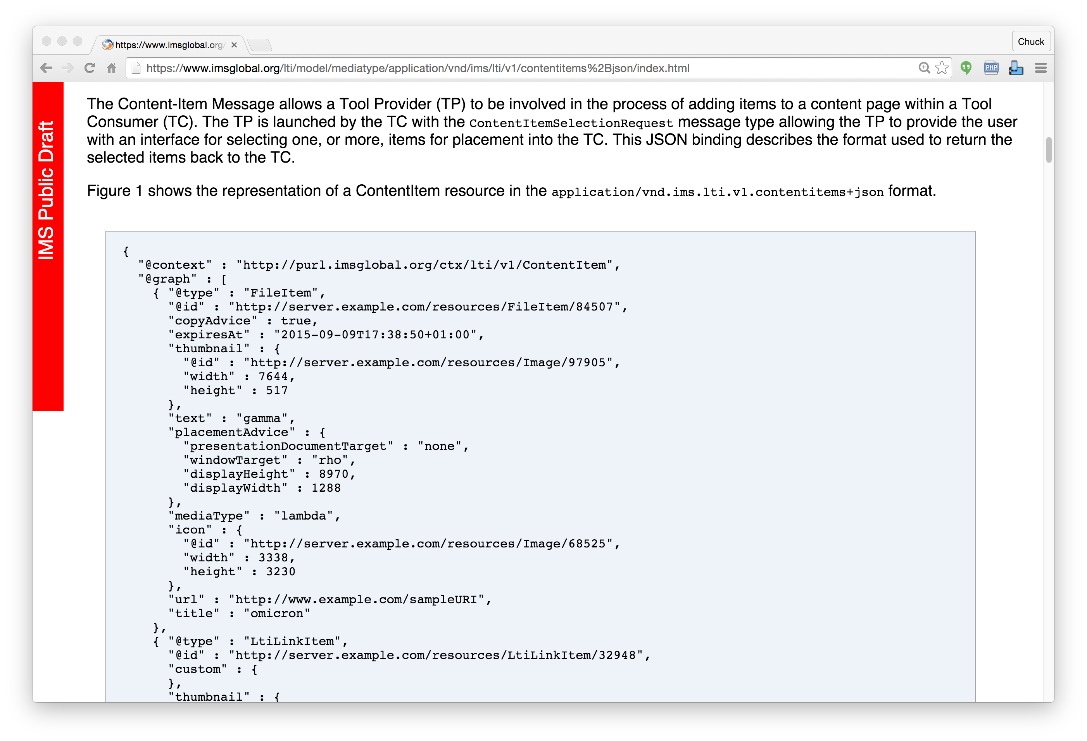
IMS
Content
Item
https://www.imsglobal.org/specs/lticiv1p0

Slide 45

IMS Content Item Launch
APP
Launch Picker
APP
LMS
APP
Launch Picker
Content
Repository

Slide 46
IMS Content Item Return
APP
LMS
APP
APP
APP
URL, Configuration
Content
Repository
IMS Common
Cartridge (ZIP File)

Slide 47
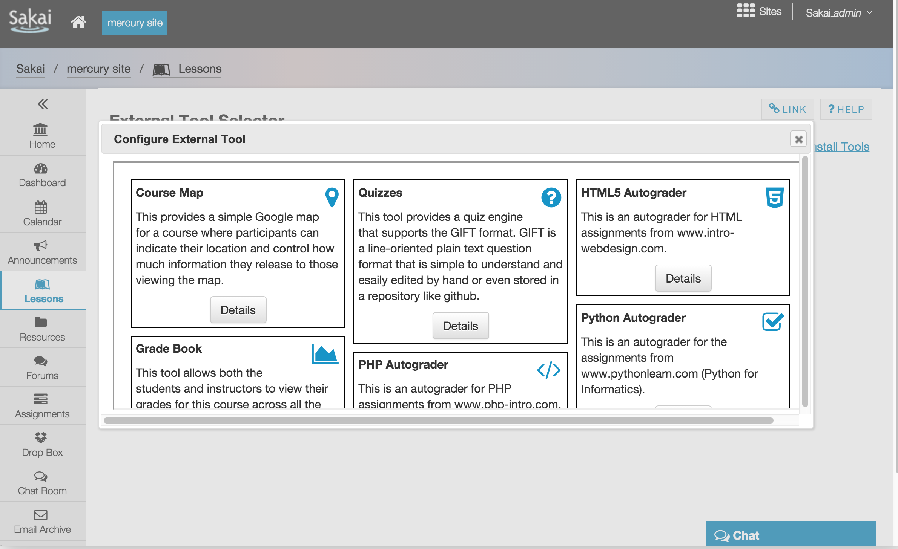

Slide 48
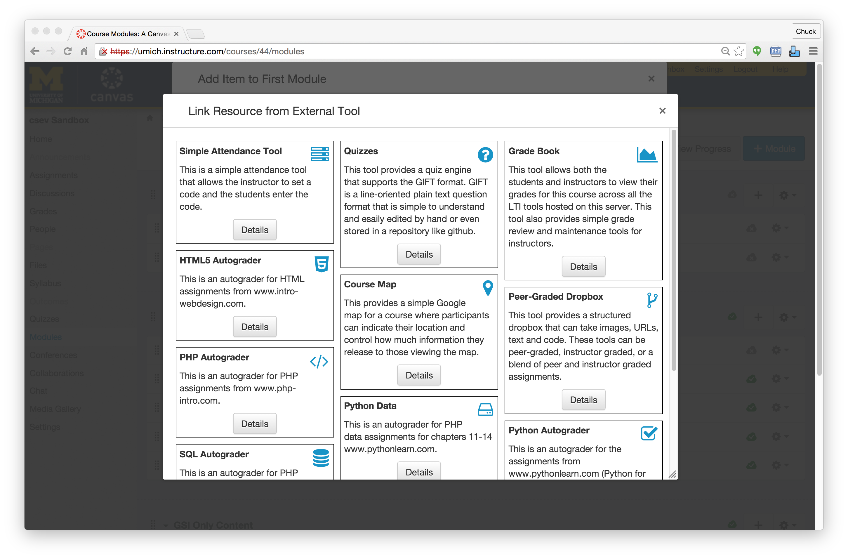

Slide 49
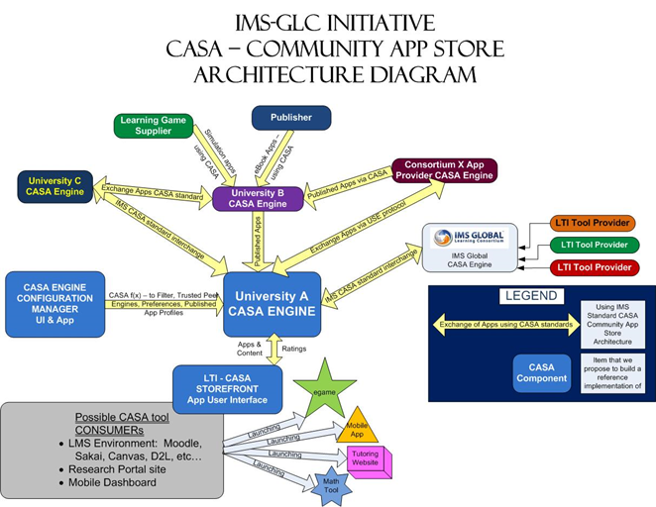
Relaunching

Slide 50
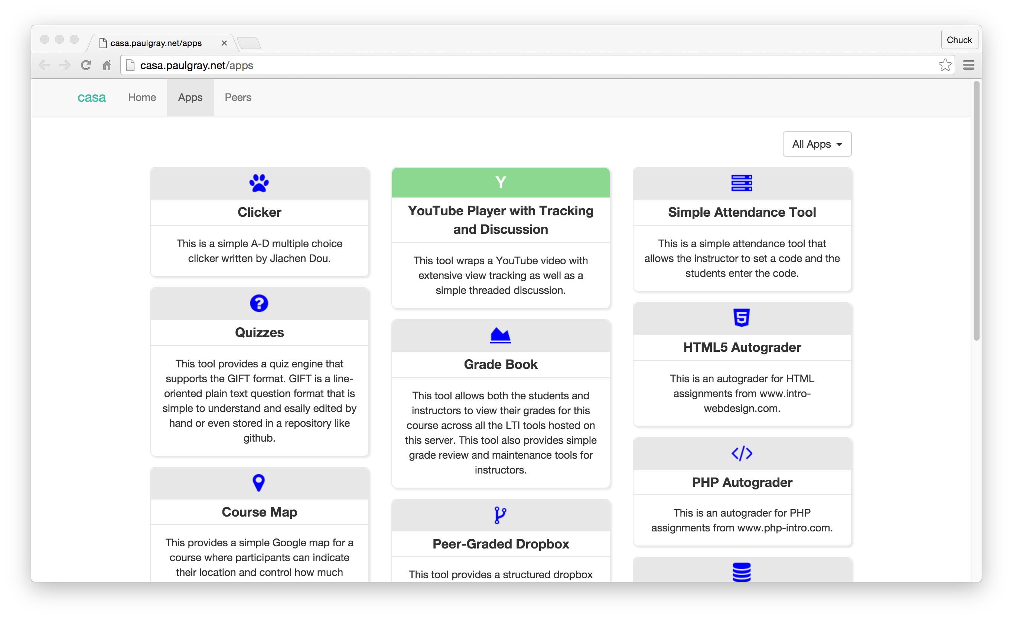

Slide 51
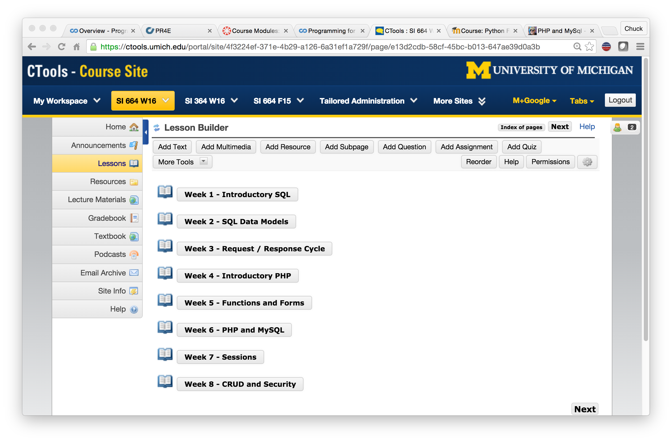

Slide 52
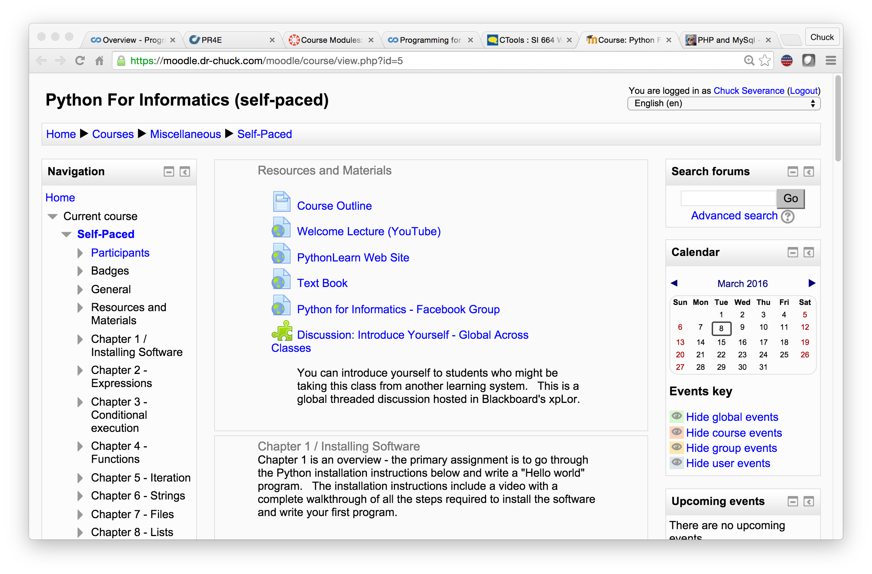

Slide 53
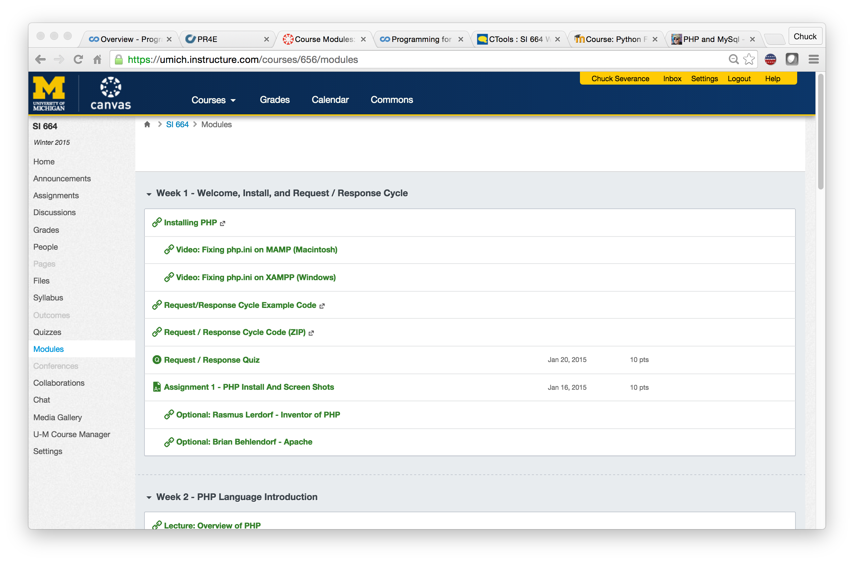

Slide 54
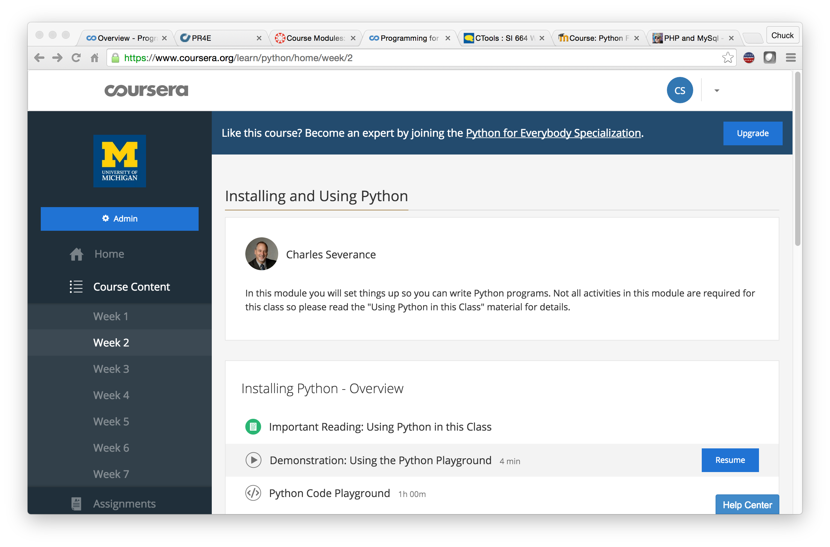

Slide 55
PY4E.com

Slide 56

Tsugi is Ongoing Research
Growing, evolving based on experiments
In incubation as a open source project in the Apereo Foundation
Participating in IMS Working Groups
Need adopters
Need collaborators
Need funding for grad students, travel, etc
www.tsugi.org

Slide 57
Source: Ian Dolphin

Slide 58




In building the NGDLE, open source will be first to market..

Slide 59
Workshop
Sep. 21 2:00pm – 5:00pm, Exhibition hall of Coex
Workshop I: Building the infrastructure for the Next Generation Digital Learning Environment using Tsugi
This workshop will introduce attendees to the Tsugi learning application framework. With Tsugi you can easily develop rich and powerful tools that plug in seamlessly to any LMS. Tsugi implements the IMS standards and provides easy-to-use APIs to allow developers to focus on building new and interesting tools. Tsugi tools support IMS Learning Tools Interoperability (LTI) 1.1, LTI 2.0, IMS ContentItem and IMS Community App Sharing Architecture (CASA) and can be served as part of an interoperable learning Tool App store. As new standards are approved such as those for analytics, Tsugi will support those standards as well.

Slide 61
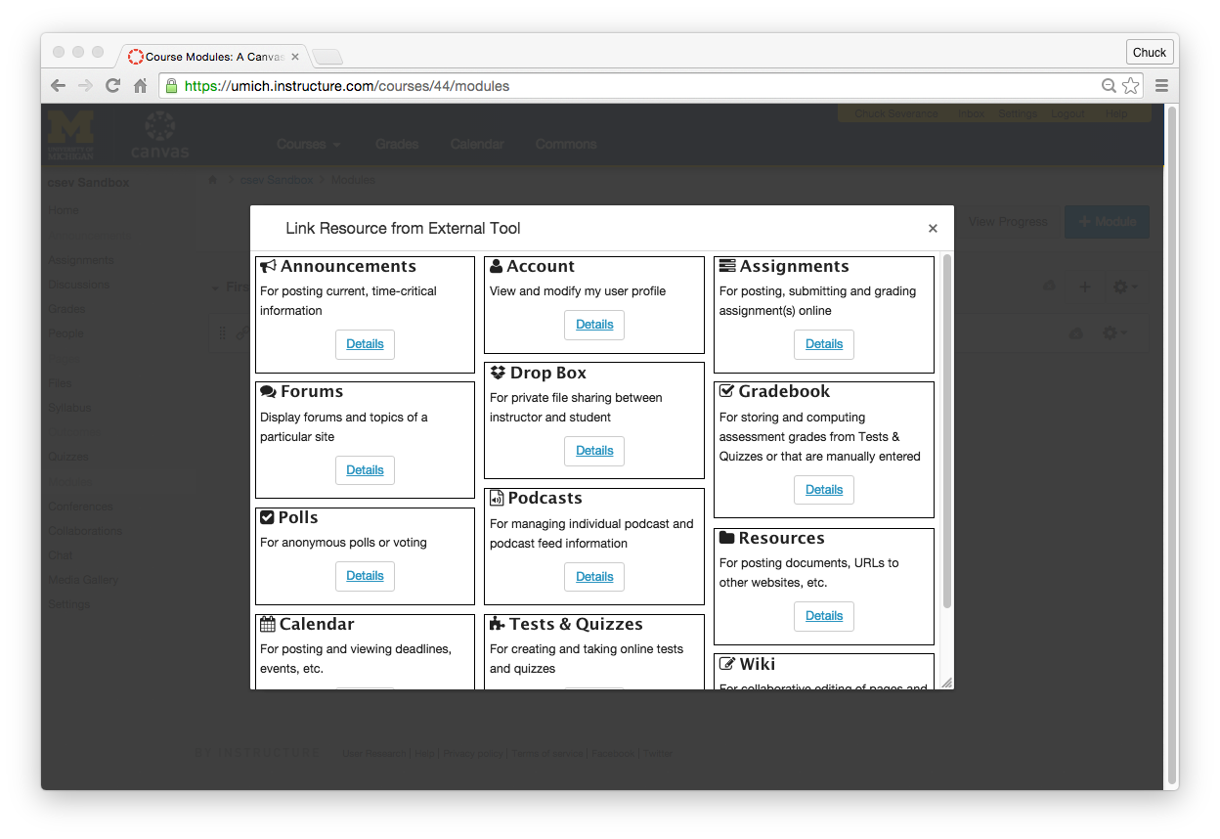

Slide 62
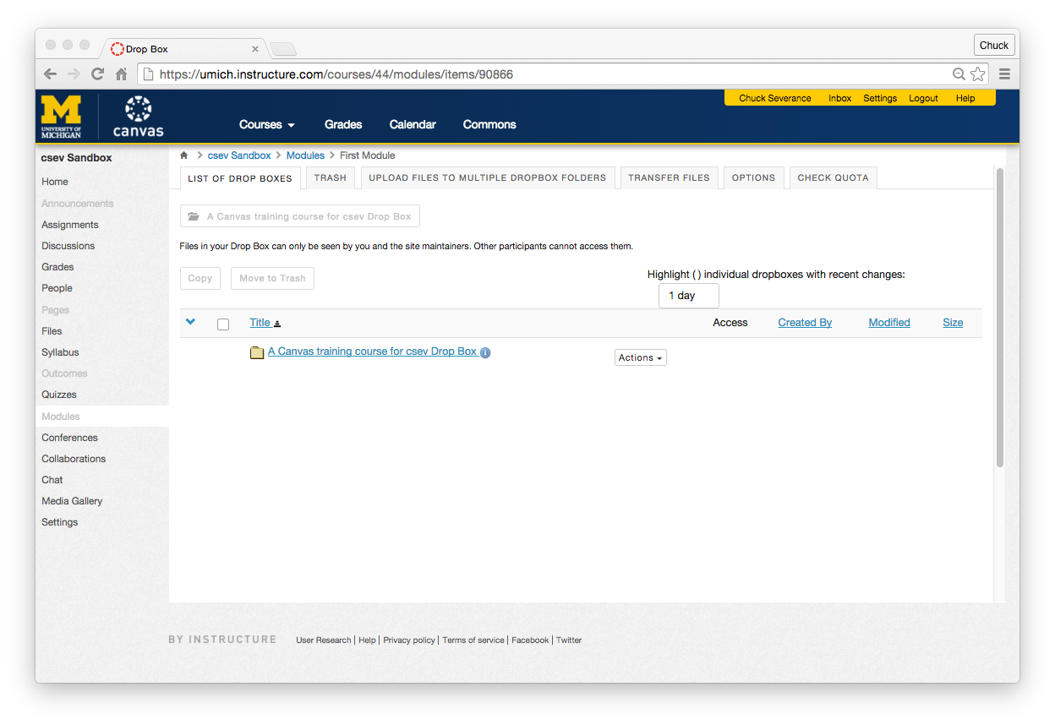

Slide 63
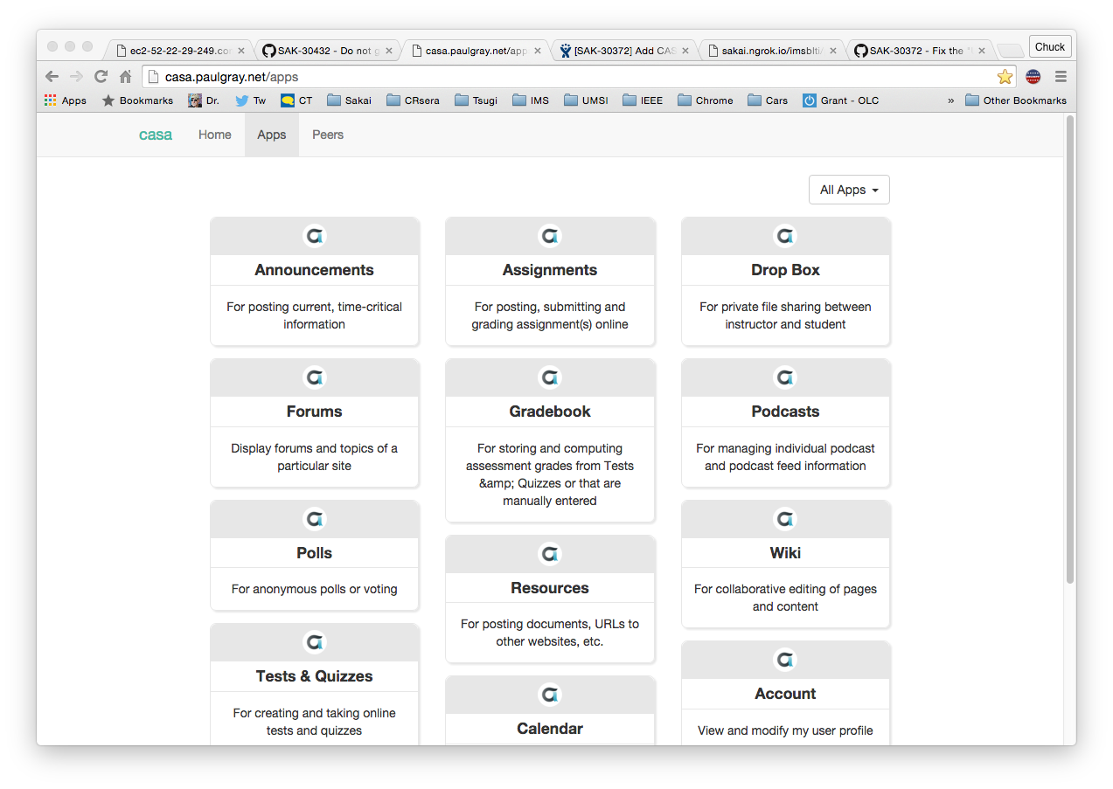

Slide 64
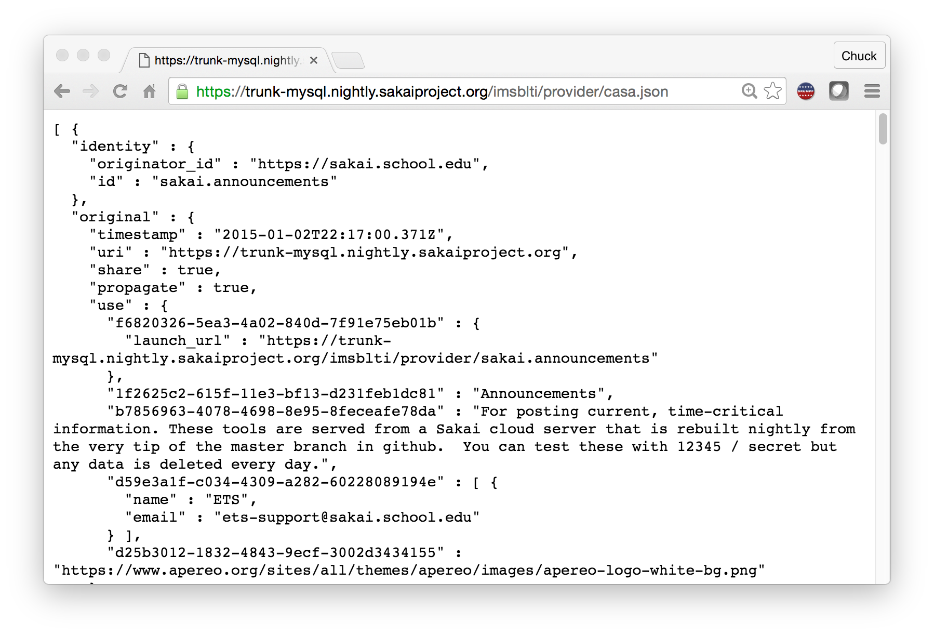

Slide 65

CASA
App Store
IMS CASA
IMS ContentItem

Slide 66
Standards Score Card
LMS | LTI 1.x | Content Item | LTI 2.x | CASA
Canvas | A | A | B+
Sakai | A | A- | A- | B
Moodle | A | B-
D2L | A
Blackboard | A
Tsugi | A+ | A | A+ | B

